Slide 1
ME 165
Basic Mechanical Engineering
Lecture 7
Analysis of Structures
Sadia Tasnim
Lecturer
Department of Mechanical Engineering, BUET

Slide 2
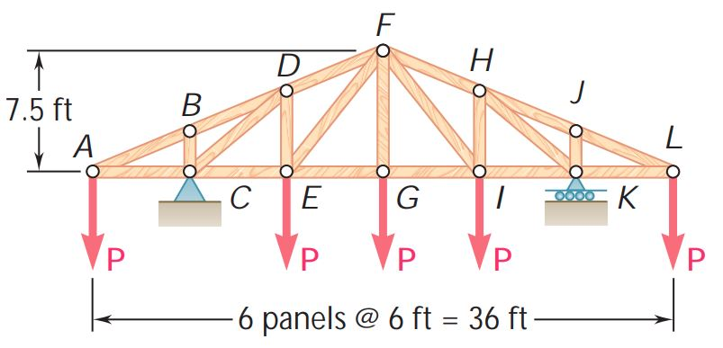
Analysis of Trusses by Method of Sections
Problem:
Determine the force in members DE and DF of the truss shown when P =20 kips

Slide 3
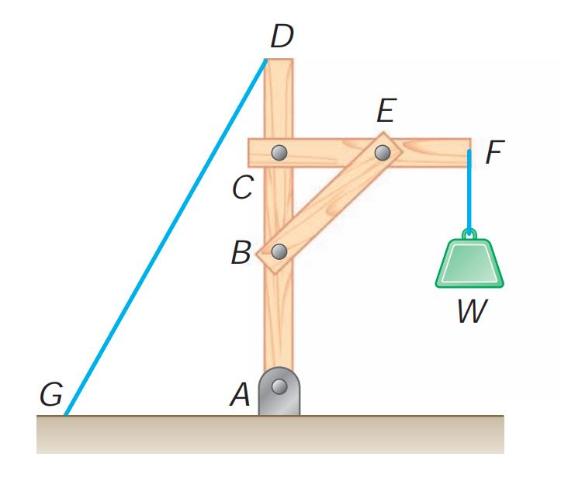
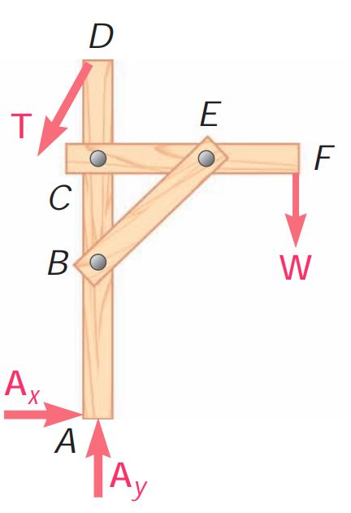
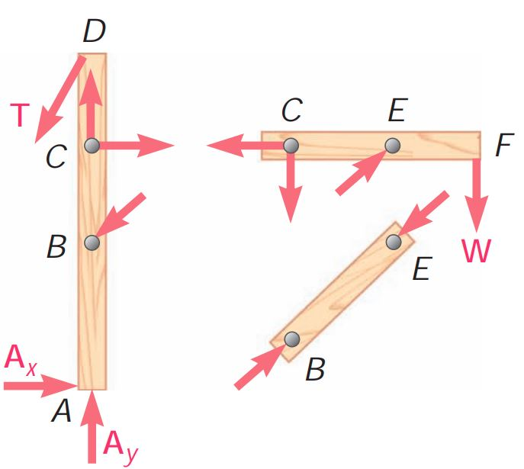
Analysis of frames
Frames are structures with at least one multi-force member. Frames are designed to support loads and are usually stationary, fully constrained structures.
A free body diagram of the complete frame is used to determine the external forces acting on the frame.
Internal forces are determined by dismembering the frame and creating free body diagrams for each component.

Slide 4
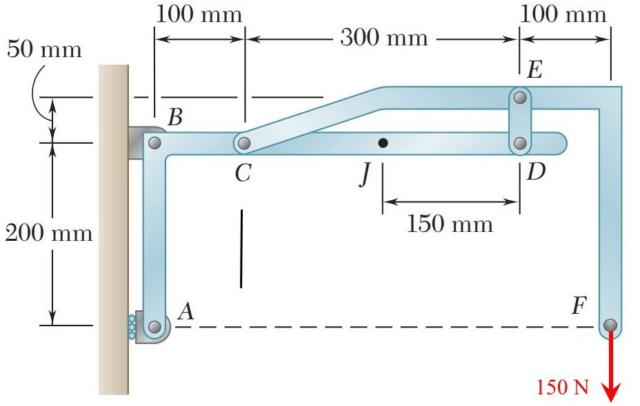
Analysis of frames
Problem:
Determine the components of all forces on member ABCD.

Slide 5
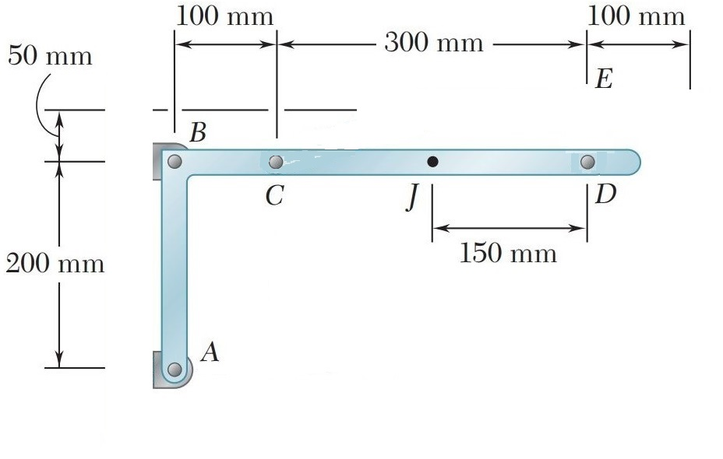
Analysis of frames
Solution:

Slide 6
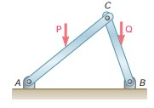
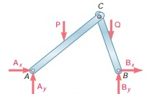
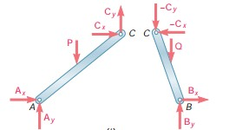
Analysis of frames
Frames Which Cease To Be Rigid When Detached From Their Supports
Some frames may collapse if removed from their supports. Such frames can not be treated as rigid bodies.
The frame must be considered as two distinct, but related,
rigid bodies.
A free-body diagram of the complete frame indicates four unknown force components which can not be determined from the three equilibrium conditions.
With equal and opposite reactions at contact point between members, the two free-body diagrams indicate 6 unknown force components.
Equilibrium requirements for the two rigid bodies yield 6
independent equations.

Slide 7
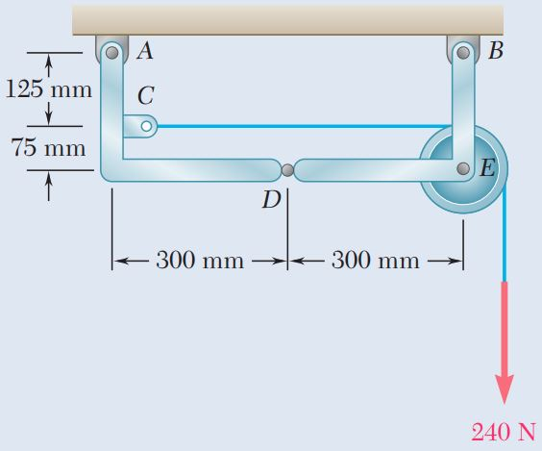
Analysis of frames
Practice Problem:
Knowing that the pulley has a radius of 75 mm, determine the components
of the reactions at A and B.

Slide 8
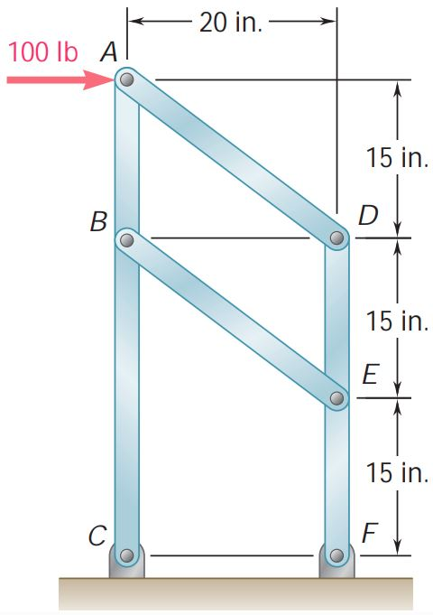
Analysis of frames
Problem:
For the frame and loading shown, determine (a) the reaction at C, (b) the force in member AD, (c) the force in member BE.

Slide 9
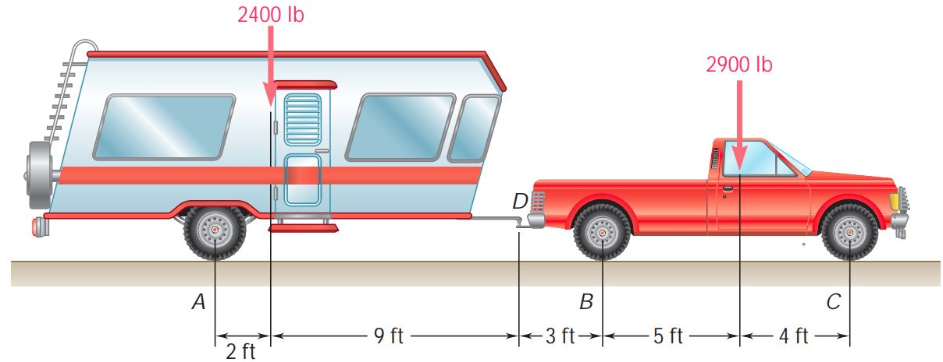
Analysis of frames
Practice Problem:
A trailer weighing 2400 lb is attached to a 2900-lb pickup truck
by a ball-and-socket truck hitch at D. Determine (a) the reactions at each of the six wheels when the truck and trailer are at rest, (b) the additional load on each of the truck wheels due to the trailer.

Slide 10
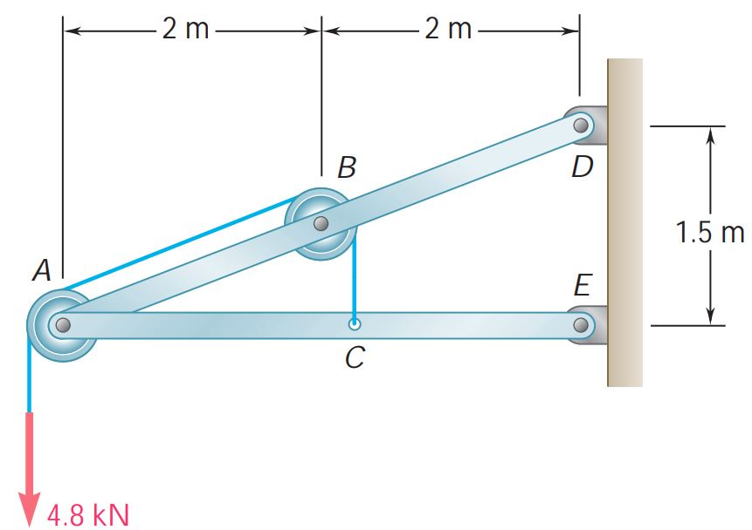
Analysis of frames
Problem:
Knowing that each pulley has a radius of 250 mm, determine the
components of the reactions at D and E
Practice: 6.76, 6.82, 6.87, 6.89,
6.94, 6.101, 6.170

Slide 11

“The Struggle you are in Today is developing the Strength you need
for Tomorrow”

